Slide 1


PULLVELI
A personalized Turf Booking Website
Akshaya M (221801002)
Bharath Kumar S (221801006)
Deepak S (221801008)

Slide 2

ABSTRACT
The turf booking platform simplifies the process of reserving sports facilities for both individuals and groups. With an easy-to-use interface, users can quickly find available turfs, compare prices, and book their preferred time slots. The platform also includes secure payment options, flexible booking features, and notifications to keep users informed. For turf owners, it offers tools to better manage bookings and maximize usage. Overall, this platform makes it easier for people to access sports facilities, reduces the effort needed for booking, and encourages more active lifestyles.

Slide 3
OBJECTIVE
AIM
GOAL
The aim is to enhance the user experience by providing a simple, intuitive platform that reduces the time and effort involved in booking sports venues.
The ultimate goal is to promote greater access to sports facilities, encourage active participation in sports, and support venue owners in optimizing their resources through better management and increased bookings.

Slide 4
EXISTING SYSTEM AND ITS DRAWBACK
EXISTING SYSTEM
DRAWBACK
User Experience
Performance Issues
The Turf Town app offers a comprehensive and user-friendly interface for booking sports venues. Users can book facilities for multiple sports such as football, basketball, cricket, and badminton. The app's design focuses on ease of navigation, allowing users to quickly find and reserve available sports turfs in their locality.
Some users have reported bugs and slow performance, which can disrupt the booking process and lead to frustration.
Venue Availability Transparency Issues
Users might find it difficult to assess the quality and exact availability of turfs due to insufficient information or inaccurate booking statuses
Social Features
Turf Town integrates social networking features, enabling users to connect with friends, form sports groups, create events, and join clubs. This aspect of the app enhances user engagement by allowing players to build and interact within a sports community
Limited Personalization
The app lacks advanced personalization features that could tailor the user experience based on individual preferences and behavior.
Performance and Updates
Turf Town is regularly updated with new features and sports options, ensuring it remains relevant and appealing to users. Recent updates have added support for new sports like tennis, padel, and squash, expanding its reach.

Slide 5
PROPOSED SYSTEM AND ADVANTAGES
PROPOSED SYSTEM
ADVANTAGES
Pullveli is an intuitive and personalized turf booking platform designed to meet the unique preferences of each user. It enables users to seamlessly book nearby turfs for their preferred dates and times, ensuring a convenient and flexible experience. With integrated features such as user reviews and tailored recommendations, Pullveli enhances the overall booking process, creating a streamlined and hassle-free environment for users.
Personalized Experience
Convenient Booking
Informed Decision-Making
Streamlined Process

Slide 6
SYSTEM REQUIREMENTS
FUNCTIONAL REQUIREMENTS
The turf booking website will include user registration and authentication with email/password and social login options, plus two-factor authentication for added security. It will feature a booking management system with an interactive calendar, multi-slot bookings, and cancellation options. An admin panel will allow for managing bookings, pricing, turf availability, and reports, with role-based access for multiple admin levels while users can access booking history and receive real-time updates.
NON FUNCTIONAL REQUIREMENTS
The turf booking website will prioritize usability with a consistent, accessible layout across devices and feedback forms for issues. It will ensure security through HTTPS, CSRF protection, and encrypted data to protect user information. The website will be scalable, supporting easy feature expansion, CDN or caching systems, and migration to robust databases like MySQL to handle increased traffic.

Slide 7
SYSTEM REQUIREMENTS
SOFTWARE REQUIREMENTS
The software requirements include any OS for development, with Linux recommended for deployment. Required languages and frameworks are Python 3.10, Flask, HTML, CSS, JavaScript, and Jinja2. MongoDB is used for development.
Key libraries and extensions include Flask-Login, Flask-WTF, SQLAlchemy, Bootstrap, JSON. Development tools include an IDE (VS Code or PyCharm), Git, and a browser (Chrome or Firefox). For deployment, Gunicorn as the WSGI server was used.

Slide 8
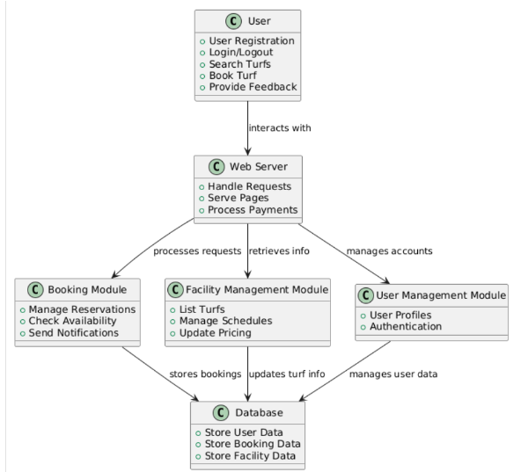
SYSTEM ARCHITECTURE
The Turf Booking System architecture includes a Web Server that handles user requests, processes payments, and interacts with various modules. The Booking Module manages reservations and notifications, while the Facility Management Module handles turf data and schedules. The User Management Module ensures secure access, and the Database stores essential data for users, bookings, and facilities, supporting efficient interactions across the system.

Slide 9
MODULES
User Authentication Module
Facility Management Module
Booking System Module
Review and Rating Module
Community Forum Module
Notification System Module
Analytics and Reporting Module

Slide 10
1. User Authentication Module
The user authentication module is designed to provide a secure and streamlined login process for users. It includes a registration system where users can create an account by entering their details, such as email, phone number, and password. To ensure data security, passwords are encrypted and stored securely in the database. The module supports multi-factor authentication for an added layer of protection, such as verification codes sent via email or SMS. Administrators and regular users are differentiated by role-based access control, ensuring that sensitive functionalities are only accessible to authorized personnel.

Slide 11
2. Facility Management Module
This module empowers turf owners and administrators to manage turf-related operations efficiently. It includes a comprehensive dashboard where they can add new turfs, edit existing listings, and remove inactive ones. Turfs can be categorized by sport type, amenities, and location, making them easier for users to find. Admins can also define available time slots, set dynamic pricing, and update turf statuses to reflect maintenance or availability changes. Additionally, this module tracks booking histories, allowing administrators to monitor usage patterns and receive valuable feedback from users for continuous improvement.

Slide 12
3. Booking System Module
The booking system module provides an intuitive interface for users to search and book turfs. It includes advanced filtering options based on location, sport, availability, and price range, enabling users to quickly find turfs that match their preferences. Real-time availability updates ensure no double bookings occur, and a secure payment gateway facilitates seamless transactions. Users can customize their bookings, selecting specific dates, time slots, and additional services. The module also supports booking modifications, including rescheduling or cancellations, while notifying users about changes or penalties involved.

Slide 13
4. Review and Rating Module
This module enhances transparency and trust by allowing users to leave detailed reviews and ratings after their bookings. Ratings are aggregated and displayed as an average score, while user reviews provide qualitative feedback that helps other users make informed choices. Turf owners can respond to reviews to address concerns or thank users, fostering open communication. This feature also helps admins identify and address common issues, ensuring continuous service improvement and user satisfaction.

Slide 14
5. Community Forum Module
The community forum module promotes interaction among users by providing a platform for discussions and event organization. Users can create or join groups based on shared interests, sports preferences, or localities. The forum supports posting and commenting, enabling users to discuss topics like sports strategies, training sessions, or match schedules. Event management tools within the module allow users to organize matches, send invitations, and track participant responses. This feature builds a sense of camaraderie among users and drives engagement within the platform.

Slide 15
6. Notification System Module
The notification system ensures users stay updated with real-time alerts and reminders. Notifications include booking confirmations, payment receipts, reminders for upcoming reservations, and alerts for special offers or discounts. The module also supports targeted notifications, such as informing users about new turfs in their area or updates on their favorite venues. Users can customize notification preferences to receive updates via email, SMS, or app notifications, ensuring timely communication without being intrusive.

Slide 16
7. Analytics and Reporting Module
This module provides turf owners and administrators with a powerful tool to analyze platform performance and make data-driven decisions. It includes dashboards with visual reports on metrics like booking trends, revenue generation, peak usage times, and user demographics. Predictive analytics capabilities help forecast demand during specific periods, enabling proactive resource management. For administrators, this module highlights underperforming turfs or services and suggests actionable improvements. These insights help optimize operations, improve customer satisfaction, and increase revenue.

Slide 17
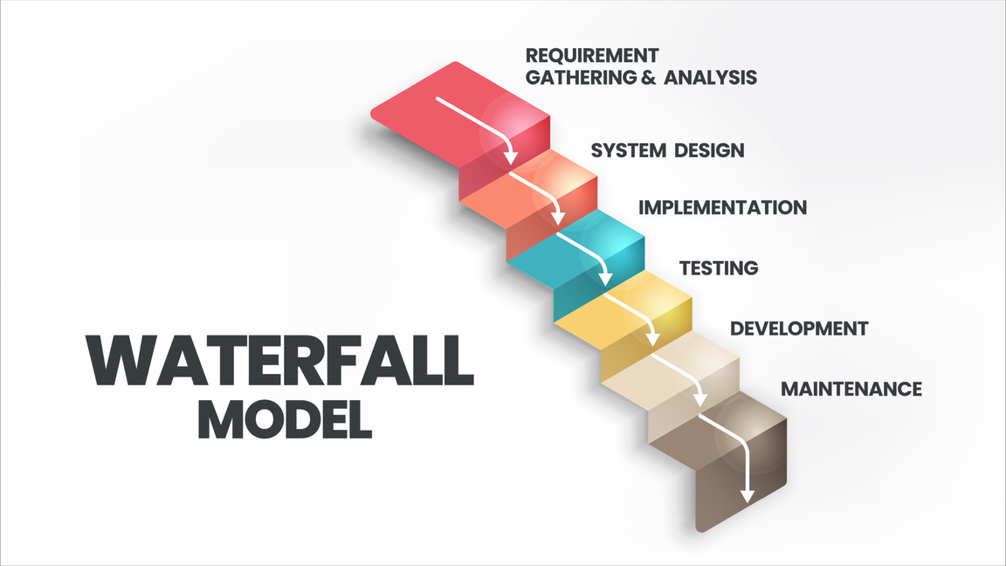
WATERFALL MODEL
The Pullveli Turf Booking Website, developed using the Waterfall Model, follows a systematic approach through Requirements, Design, Implementation, Integration, Testing, and Deployment phases. Key features include secure user authentication, real-time turf availability, booking, payment processing, and feedback management. The project ensures a user-friendly, efficient, and secure platform with a clear path for future enhancements.

Slide 18
TESTING
UNIT TESTING
Unit testing is a fundamental software testing methodology where individual components, functions, or modules of an application are tested in isolation to verify their correctness. In Flask applications, this encompasses testing routes to verify HTTP endpoints and request handling, validating database models including CRUD operations and relationships, and ensuring utility functions perform as expected. This systematic approach serves as the foundation of modern software development, offering benefits such as early bug detection, improved code quality, and enhanced maintainability. Best practices involve using testing frameworks like pytest, maintaining high test coverage, and implementing fixtures and mocks to isolate dependencies, enabling development teams to confidently refactor code and maintain reliable deployment pipelines.

Slide 19
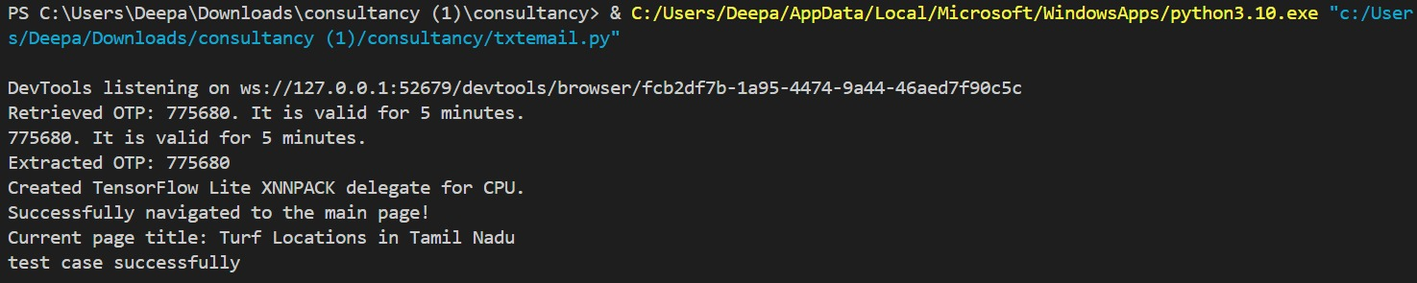
TESTING
OUTPUT

Slide 20
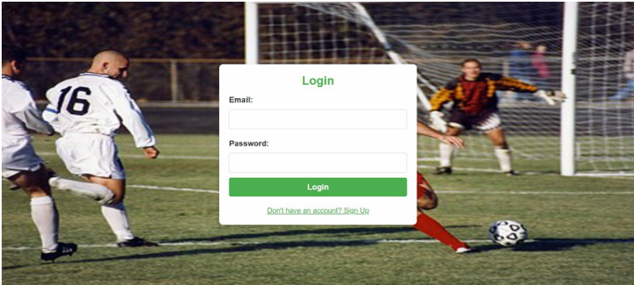
OUTPUT SCREENSHOTS

Slide 21
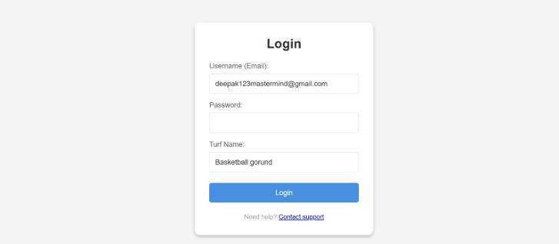
OUTPUT SCREENSHOTS

Slide 22
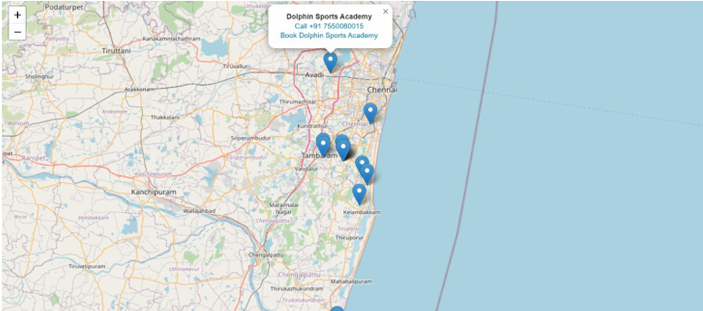
OUTPUT SCREENSHOTS

Slide 23

OUTPUT SCREENSHOTS

Slide 24
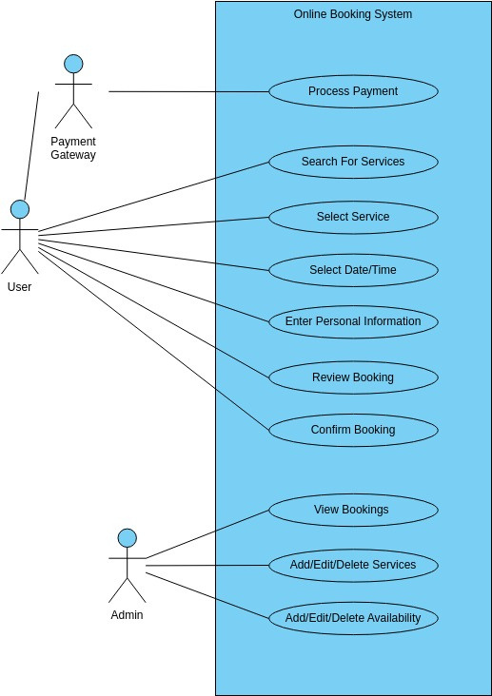
UML DESIGN
USE CASE DIAGRAM
The use case diagram outlines interactions in the Online Booking System, involving Users, Admins, and the Payment Gateway. Users perform actions like searching, booking, and making payments, while Admins manage services, availability, and bookings. The Payment Gateway ensures secure transactions, enabling a seamless and efficient booking process.

Slide 25
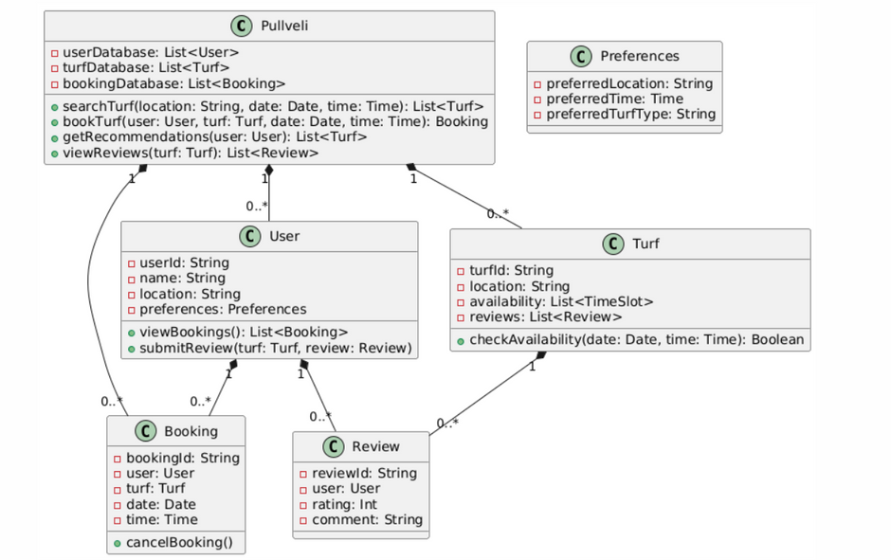
UML DESIGN
CLASS DIAGRAM
The "Pullveli" turf booking system class diagram highlights core components and their interactions. It includes classes for Users, Turfs, Bookings, and Reviews, with methods like searchTurf(), bookTurf(), and submitReview(). The system manages user preferences, turf availability, and feedback to ensure efficient booking and personalized experiences.

Slide 26
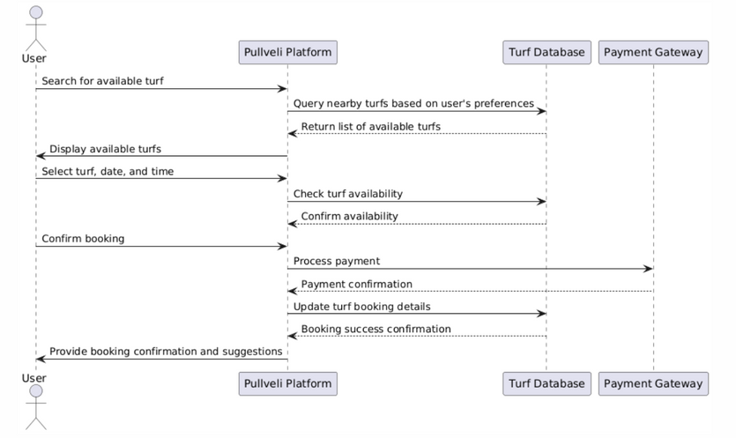
UML DESIGN
SEQUENCE DIAGRAM
The "Pullveli" sequence diagram outlines the turf booking process, where users search for available turfs, select preferences, and confirm bookings. The platform verifies availability and updates the Turf Database. Users receive booking confirmations and suggestions, ensuring a seamless and secure experience.

Slide 27
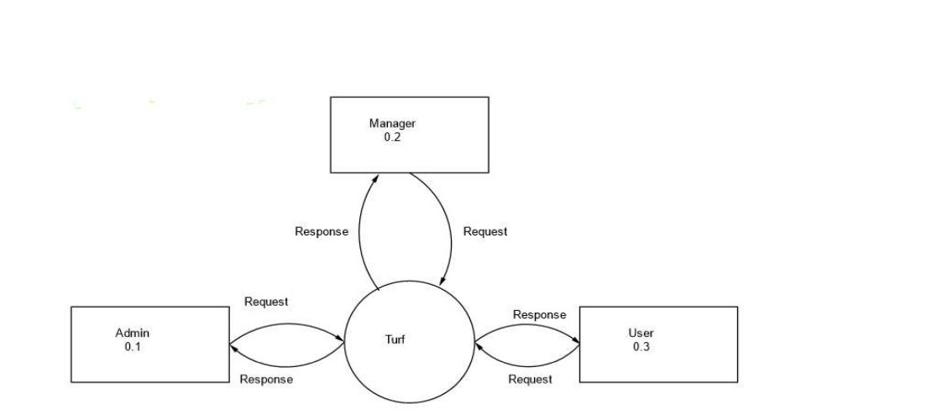
UML DESIGN
DATA FLOWDIAGRAM
Level 0

Slide 28
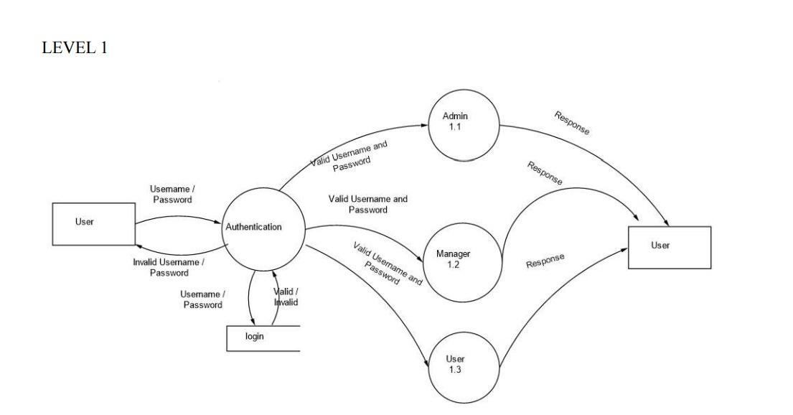
UML DESIGN
DATA FLOWDIAGRAM
Level 1

Slide 29
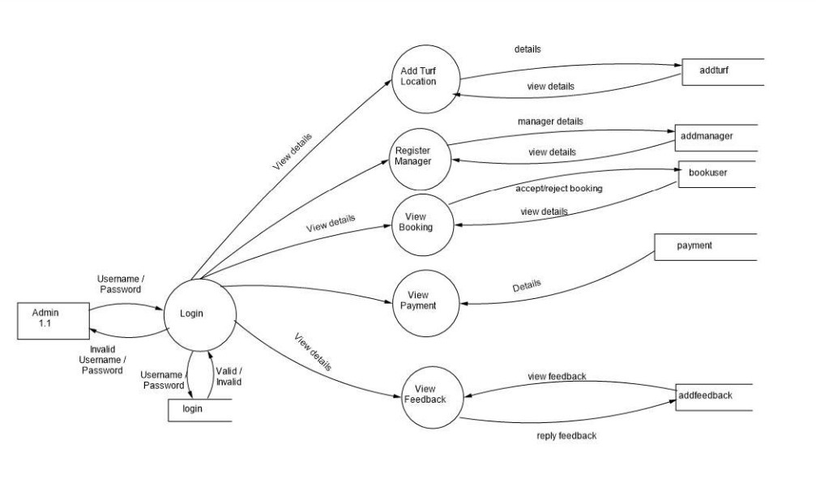
UML DESIGN
DATA FLOWDIAGRAM
Level 1.1

Slide 30
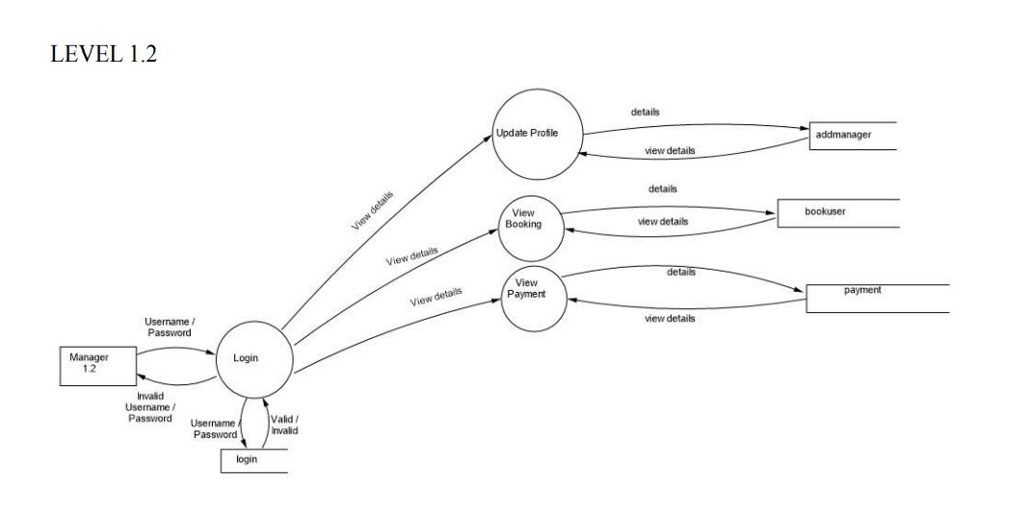
UML DESIGN
DATA FLOWDIAGRAM
Level 1.2

Slide 31
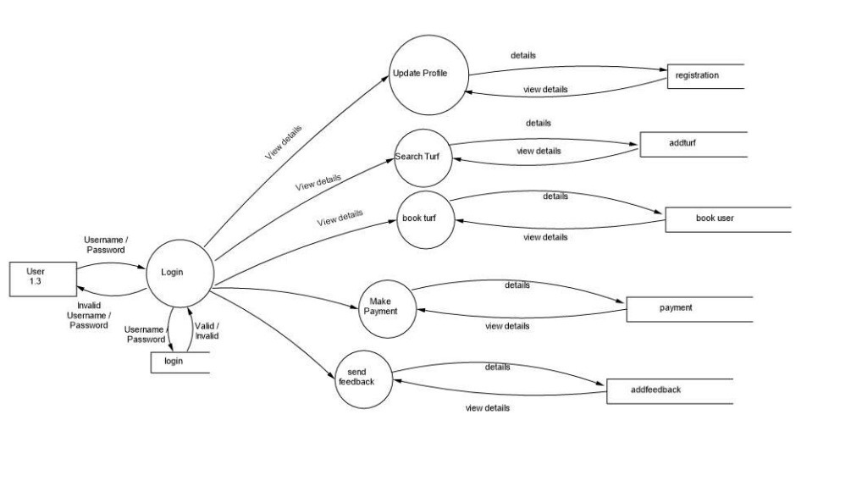
UML DESIGN
DATA FLOWDIAGRAM
Level 1.3

Slide 32
RESUTS AND CONCLUSIONS
The secure user authentication in the turf booking system enables safe registration and login, with passwords stored in a hashed and encrypted format in MongoDB, ensuring compliance with data protection standards. The website integration provides responsive support, reducing customer support load and enhancing user satisfaction. The streamlined booking system allows users to browse turfs, customize bookings, and receive timely email notifications, contributing to a smooth experience. The admin dashboard enables efficient user and booking management, with flexibility in service adjustments, while user-centric design and efficient navigation increase engagement. Ongoing chatbot improvements and potential insights into booking trends aim to optimize user and admin experiences further.

Slide 33
RESUTS AND CONCLUSIONS
CONCLUSION
In conclusion, Pullveli provides a user-centric turf booking experience that prioritizes convenience, flexibility, and personalization. By integrating features like user reviews and tailored recommendations, the platform not only simplifies the booking process but also ensures that each user's unique preferences are met. This approach fosters a hassle-free environment, making Pullveli a go-to solution for finding and booking nearby turfs with ease.

Slide 34
REFERENCES
1. Choudhury, P., & Singh, R. (2018). "Dynamic Pricing and Slot Allocation in Turf Booking Systems." International Journal of Leisure and Recreation Studies, 45, 101-109.
2. Patel, N., & Reddy, S. (2020). "Applying Machine Learning Models for Predictive Analysis in Turf Booking Platforms." Journal of Sports and Recreation Management, 35(4), 211-223.
3. Kumar, V., & Sharma, A. (2021). "An Empirical Analysis of Reservation System Optimization for Sports Facilities." Procedia Computer Science, 187, 1570-1577.
4. Ramachandran, L., & Pillai, A. (2019). "User Behavior Analysis in Sports Facility Reservations Using Predictive Analytics." Journal of Leisure and Recreation Research, 50(3), 201-210.

